Slide 1

Customer Booking Prediction Model Summary

Slide 2
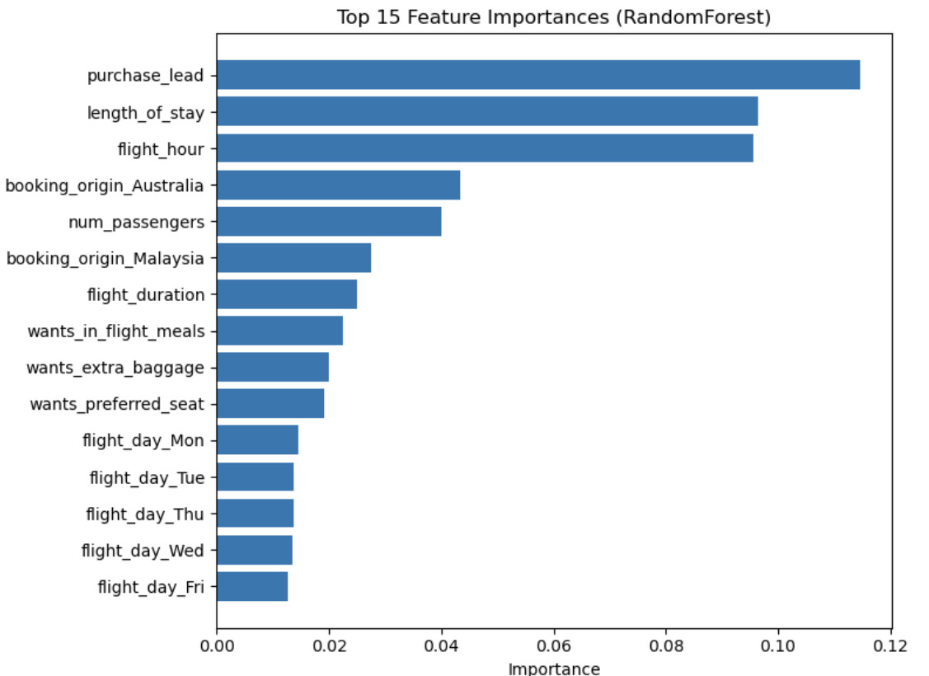
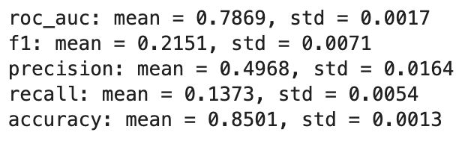
Performance
Dataset: Airline customer booking data (~50k rows)
Target variable: booking_complete
(1 = booking, 0 = no booking)
Model: Random Forest with OneHotEncoding
Validation: 5-fold stratified cross-validation

